Slide 1

Your weekly Azure news fix.
Azure Weekly is a summary of the week's top
news in the Microsoft Azure ecosystem, as well as
interesting historic content that's well worth reading.
It's aimed at developers, architects, IT Managers,
infrastructure folk, or anyone trying to keep on
top of the latest Azure developments.
Subscribe at: http://azureweekly.info
Azure Weekly

Slide 2
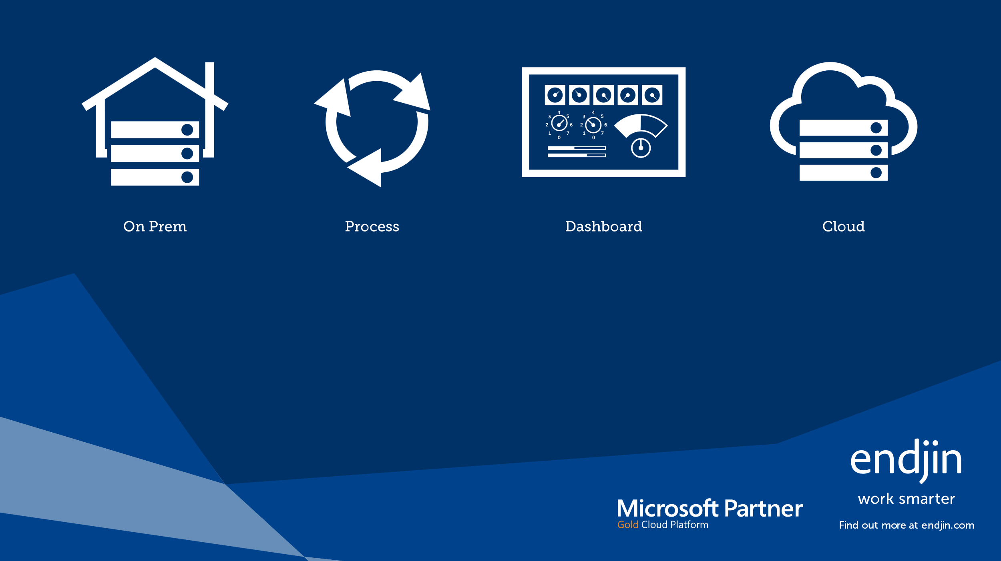
Cloud Migration
Daunted by the complexity of adopting The Cloud? Don't panic,
we've got a process you can use.
For an easy guide to the process, we have created a free poster:
https://endjin.com/thought-leadership/cloud-migration-process

Slide 3
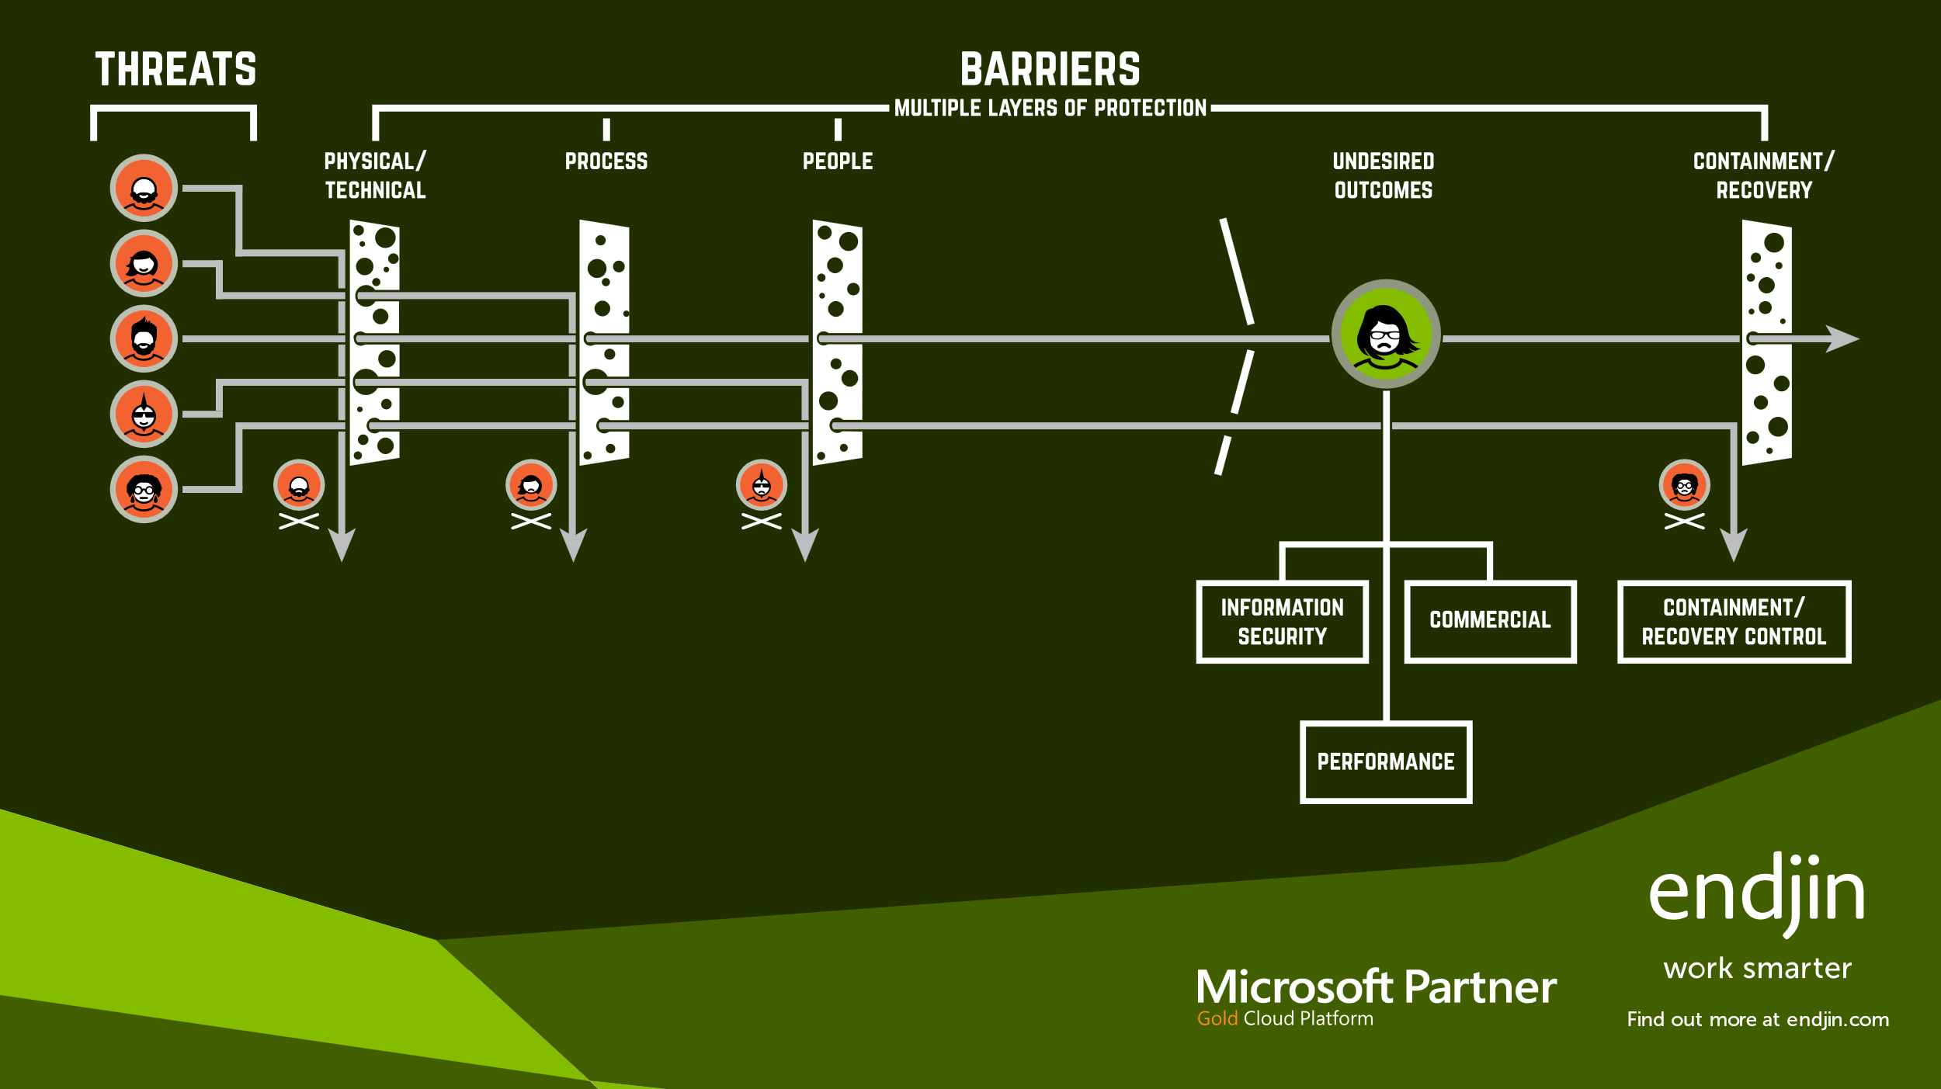
Security & Compliance
For an easy guide to the process, that lists 21 threats and
42 barriers grouped into four discrete categories, we have
created a free poster:
https://endjin.com/thought-leadership/cloud-adoption-risk-model

Slide 4
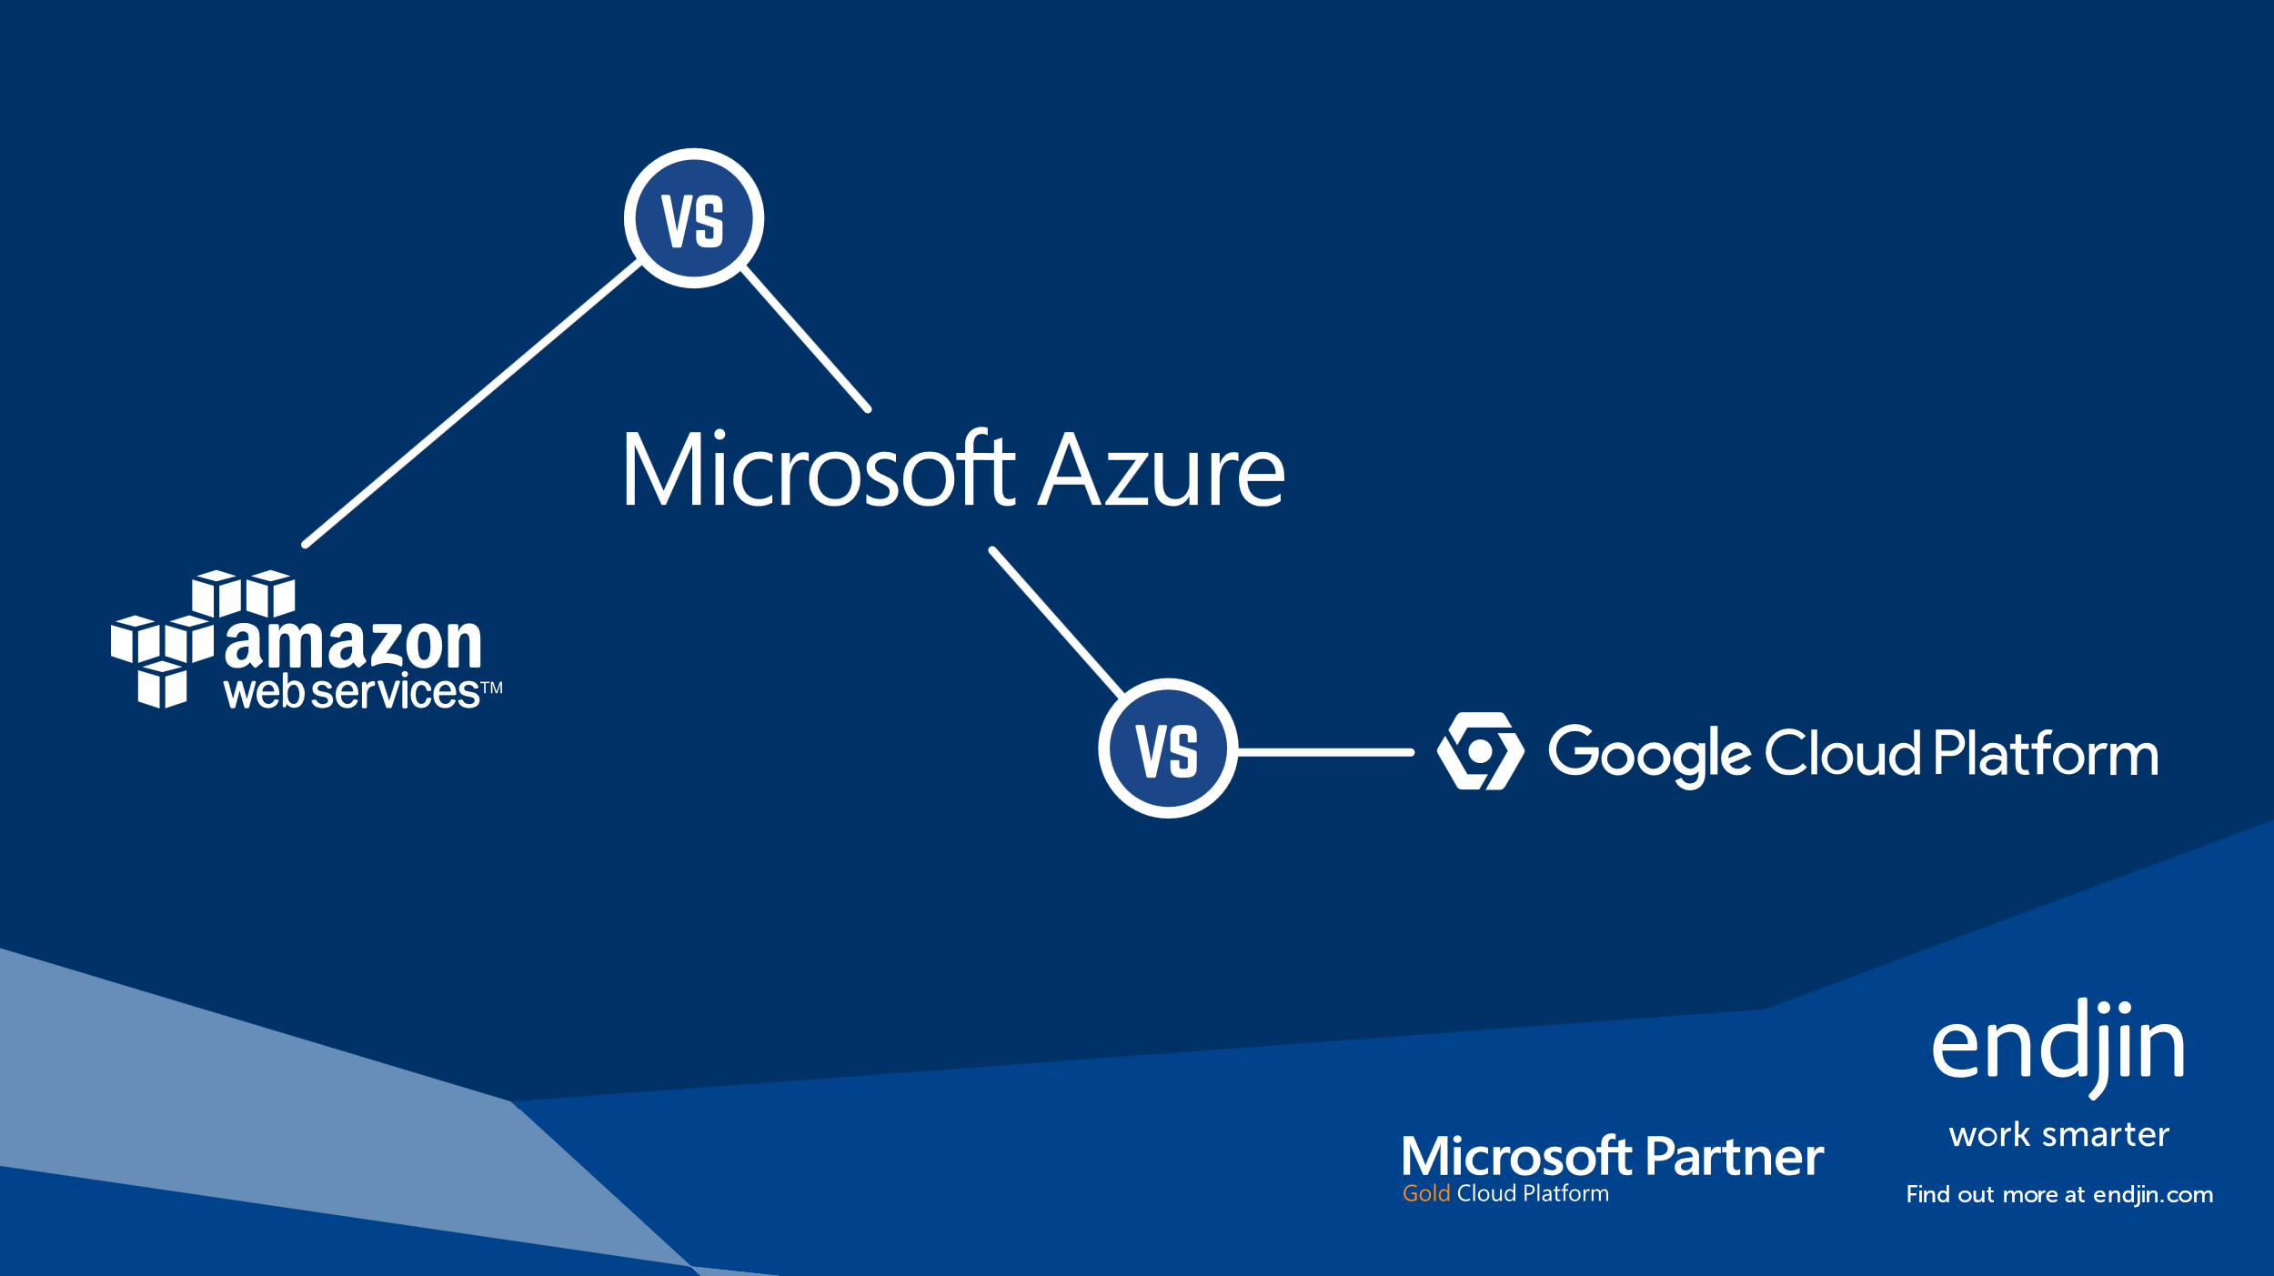
Cloud Comparison
Confused by the cloud services offered by Microsoft, Amazon & Google?
For an easy side-by-side comparison, we have created a free poster:
https://endjin.com/thought-leadership/cloud-platform-comparison

Slide 5
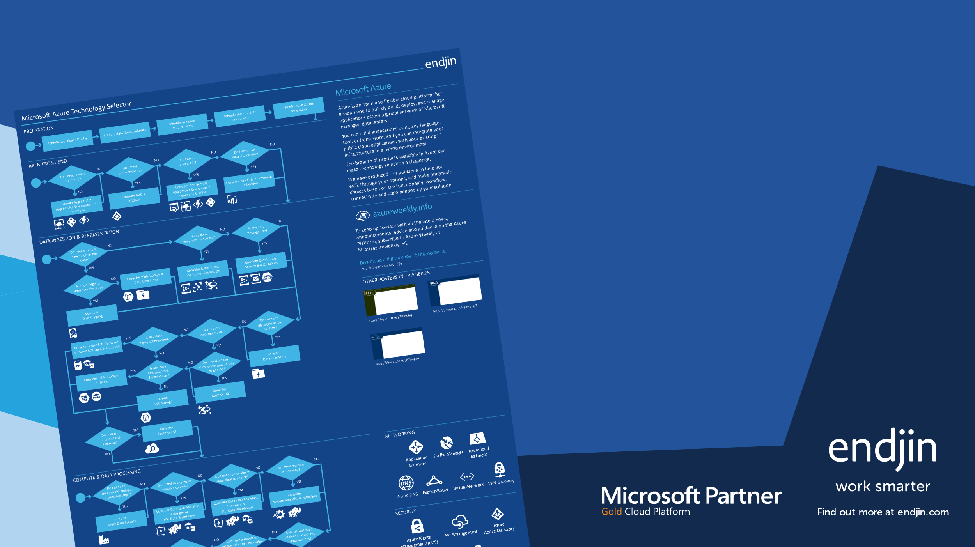
Azure Technology Selector
The breadth of products available in Azure can
make technology selection a challenge.
For an guidance through a maze of options,
we have created a free poster:
https://endjin.com/thought-leadership/azure-technology-selector

Slide 6

API Matrix
Want to join the API Economy but don't know where to start? Don't panic, we've got a process you can use.
The API Maturity Matrix provides an easy way to assess and track your organizational capabilities across the areas required
to deliver an API based
business, including examples
of practical next steps for
an organization that's new
to the API Economy.
Download a free maturity matrix at:
https://endjin.com/thought-leadership/api-maturity-matrix

